Slide 1
MIILA: Leading Innovative Solutions
(Program Overview Session)
Good Afternoon & Welcome!!
It’s a New Day!
Monday, May 13, 2024
Notes:
Good afternoon everyone and welcome to the MIILA: Leading Innovative Solutions (Program Overview Session)

Slide 2
LEARNING OBJECTIVES
At the completion of the Leading Innovation session, participants will be able to recognize the following:
The importance of leading innovations at MSM
Their role in Leading Innovation at MSM
How to Navigate LaunchPath and ETHOS
How to optimize your learning experience & successfully earn your certification
Notes:
As Steven Covey stressed, let start off by getting a clear understanding of the end in mind of today’s session.
That is, what we hope you will be able to do having completed this session.

Slide 3
DISCUSSION ITEMS
INTRODUCTION
THE IMPORTANCE OF LEADING INNOVATION AT MSM & YOUR ROLE
MOREHOUSE SCHOOL OF MEDICINE INTELLECTUAL PROPERTY POLICY
NAVIGATING LAUNCHPATH AND ETHOS
GETTING THE MOST OUT OF YOUR LEARNING & SESSION REQUIREMENTS EXPECTATIONS
Notes:
Here are the discussion items we will cover to achieve the learning objectives.
We will open with introductions.
Second, discuss the why leading innovation is important at MSM and your role
Third, discuss how to navigate LaunchPath and ETHOS
Conclude by discussing expectations That is, what we hope you will be able to do having completed this session.

Slide 4
INTRODUCTIONS

Slide 5

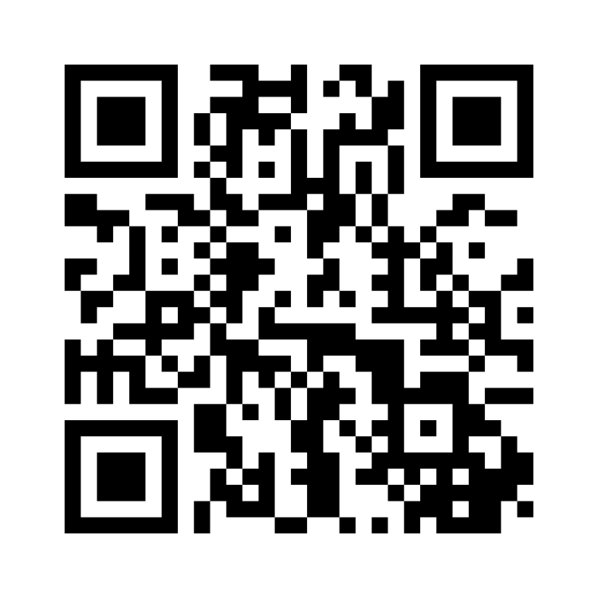
Let’s Get to Know One Another!!
Menti.com | 3482 3157
  Questions
Who is an innovating leader that you admire and Why?
Why is leading innovation important at MSM?
What do you believe is your role as a MSM leader of innovation?
What do you hope to get out of your learning experience?
Notes:
Let’s open by getting to know one another.
Please take 2 to 4 minutes to address the items and be prepared to introduce yourself accordingly to your colleagues.

Slide 6
THE IMPORTANCE OF INNOVATION
& YOUR VITAL ROLE

Slide 7
Why Is Leading innovation at MSM important?

Slide 8
Higher Education Institutions
Politics
Economy
Socio-Demographics
Globalization & COVID
Technology
Notes:
The magnitude of change facing private, public, not-for-profit, and higher education institutions (HEIs) across the world has been driven by the following major drivers of change (1) political, economic, socio-demographic, and technology (PEST) trends and events, (2) globalization, and COVID most recently.
Thus, higher education leaders are facing enormous pressure to foster innovations as a means of (a) adapting their education systems to the reality of their changing environments, (b) excelling at their mission and vision, (c) carving out a competitive advantage in the higher education student market, and (d) sustaining long-term growth and success.
Fostering innovations in higher education consists of higher education leaders introducing and cultivating new education models or new ways of thinking into their HEIs that are representative of the reality of their changing environment.
Ultimately, the pressure to foster innovations in response to their changing environments has created the need for higher education leaders to effectively lead innovations or foster and sustain an innovative culture.

Slide 9
What is your role?

Slide 10
Leading Innovation
Model the Way
Inspire a Shared Vision
Challenge the Process
Encourage the Heart
Enable Action

Slide 11
MOREHOUSE SCHOOL OF MEDICINE
INTELLECTUAL PROPERTY POLICY

Slide 12
Intellectual Property Policy
The School supports the preparation and publication of copyrightable works resulting from the teaching, research, scholarly, and artistic endeavors of faculty, staff, and students as part of their unique roles at the School.
The School seeks to foster an intellectually stimulating environment in which creative efforts and innovations are encouraged and rewarded, the careers of its members are enhanced, and the School’s reputation and prestige are furthered.
The School respects, acknowledges, and promotes the intellectual property rights in works created by its members, where applicable.

Slide 13



Intellectual Property Policy
Intellectual Property:
Includes, but is not limited to, Inventions (whether patentable or not) patents, patent applications, Copyrightable Materials, Trademarks, service marks, domain names, Trade Secrets, trade dress rights, formulas, designs, Software, programming code, New Media, intangible rights in machines, compositions of matter and devices, techniques, processes, procedures, systems, or formulations.
What
Who
How
60
40
Faculty
Postdoctoral Fellows
Residents
Students
Other Persons Employed
Staff
Policy for copyrightable material or patenting any new and useful process, machine, manufacture, composition of matter, o any new and useful improvement
Net Distribution
of Income

Slide 14
NAVIGATING LAUNCHPATH & ETHOS

Slide 15
OPTIMIZING LEARNING EXPERIENCE &
SESSION REQUIREMENTS

Slide 16
Optimizing Learning
Bring Your Prior Full Knowledge of Leadership & Innovation!! Challenge Your Assumptions & Adopt New Ways of Thinking Test Your New Knowledge through Application
Session Requirements (Earning Certification)
Self – Study Demonstrate Knowledge (Weekly Activities & Huddles) Culminating Project (PPT Video Presentation)

Slide 17
Weeks | Topics | Learning Objectives
1 | MIILA Program Overview | At the completion of the session, participants will be able to recognize the following: Colleagues Perspectives (Leading Innovation) & Learning Aspirations The Importance of Leading Innovations at MSM and Role MSM Intellectual Property Policy How to Navigate LaunchPath and ETHOS How to Optimize Learning Experience & Successfully Earn Certification
2 | Leading Innovation the MSM Way | At the completion of the session, participants will be able to: Recognize the significance of leadership to foster and sustain an innovative culture. Differentiate between leading and managing innovations. Identify and demonstrate the foundational practices in Leading Innovation the MSM Way.
3 | Team Huddle (Hybrid: Mondays 4:00 – 6:00 PM Eastern Time) Transferring Ideas into Innovation | At the completion of the session, participants will be able to: Identify the steps of Design Thinking (innovation methodology. Recognize the importance of empathizing to uncover unmet needs, which lead to idea generation. Use innovation tools to empathize and select a creative solution.

Slide 18
Weeks | Topics | Learning Objectives
4 | Ideation and Business Cases | At the completion of the session, participants will be able to: Recognize the importance of a business case. Identify the key components of a compelling business case. Develop a business case.
5 | Prototyping and Testing | At the completion of the session, participants will be able to: Develop a prototype or minimum viable product Test and refine hypotheses to ensure solutions meet identified user needs. Evaluate and validate scalability.
6 | Team Huddle (Hybrid: Mondays 4:00 – 6:00 PM Eastern Time) Develop and Manage Implementation Plan | At the completion of the session, participants will be able to: Develop and manage the execution of the innovative solution Monitor and control the results/outcomes of the solution to ensure user needs are being met. Identifying tools used to monitor and control results, outcomes and support decision making.
7 | Draft and Finalize Presentation | N/A

Slide 19
Weeks | Topics | Learning Objectives
8 | Presentation and Closeout | At the completion of this week, participants will be able to: Generate power-point slide deck containing the following: Cover page Overview slide outlining presentation flow. How you empathized and generated a creative solution. Business Case MVP Minimum Viable Product Implementation work plan (Gant chart) and dashboard Describe leadership practices required for successful implementation of your project

